Slide 1



Introduction to Excel:
Interface, Data Entry & Basic Functions

Slide 2
Learning Objectives
By The End Of This Session, Learners Will Be Able To:
1
Understand The Excel Interface And Its Components
2
Navigate Efficiently Within Worksheets And Workbooks
3
Perform Data Entry And Basic Formatting
4
Sort And Filter Data Effectively
5
Use Basic Aggregate Functions (SUM, AVERAGE, COUNT, MIN, MAX)
6
Apply Functions To Perform Simple Data Analysis

Slide 3
Schedule Breakup
Section | Duration
Introduction | 10 mins
Excel Interface & Navigation | 40 mins
Data Entry & Formatting | 35 mins
Break | 10 mins
Sorting & Filtering | 35 mins
Basic Functions | 25 mins
Doubt Resolution | 15 mins
Wrap-up | 10 mins
Total | 180 mins (3 hrs)

Slide 4

Why learn EXCEL ?
1
Most widely used tool in Data Analytics.
2
Great for data entry & quick calculations.
Useful for reporting & visualization (charts, pivot tables).
3
Quick for what-if analysis and decision support.
4
Examples: Sales reports, budgets, student marksheets, attendance records.
5

Slide 5

Let’s Start With…
Excel
Interface

Slide 6
Excel Ribbons and Tabs
Ribbons :
1
The Ribbon is the horizontal strip containing all the tools and commands in Excel.
Tabs :
2
Most common Tabs used are Home, Insert, Page Layout, Formulas, Data,
Organize commands into logical groups.
Quick Access Toolbar :
3
The Quick Access Toolbar is a small, customizable toolbar in Excel.
It gives you one-click access to commands you use frequently, without switching tabs.

Slide 7
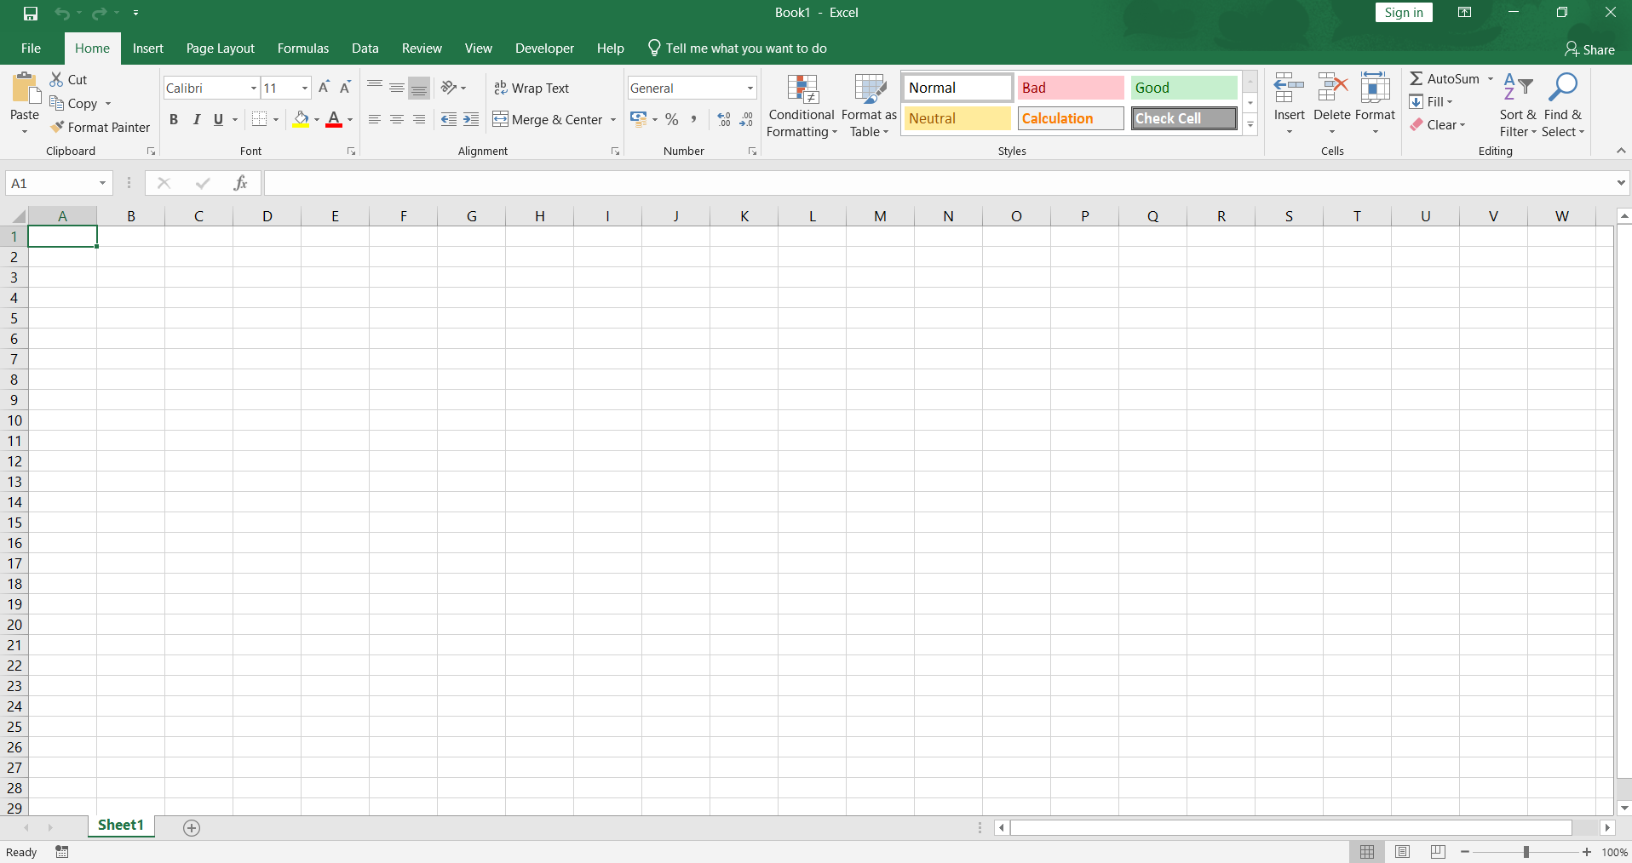
Quick Access Toolbar
Menu Tabs
Ribbons
Name Box
Column Number
Active Cell
Formula Bar
Row Number
Worksheet Tab

Slide 8
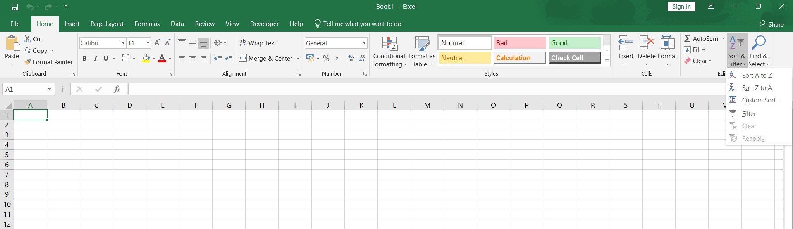
Home Tab
For change of Font color, style and size
For applying formatting to the selected ones
For find & select or for sort & filter of any text. Also for aggregate functions
For Alignment of content
For inserting, deleting and formatting of cells
For Cut, Copy, Paste of selected
For changing datatypes, currency and also for changing number of digits after decimal

Slide 9
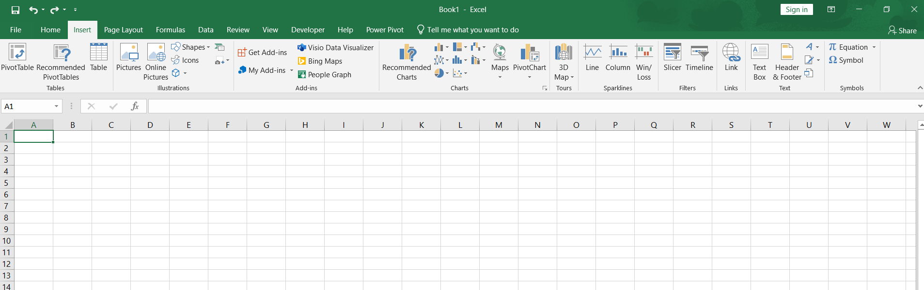
Insert Tab
For inserting Pictures, shapes, Icons, SmartArt Graphics, 3D Models
For inserting Sparklines on charts
For inserting Text Box, Signature, Header & Footer
For adding Table, Pivot Tables
For inserting different charts
For inserting slicer to the table
For inserting Equations, Symbols

Slide 10
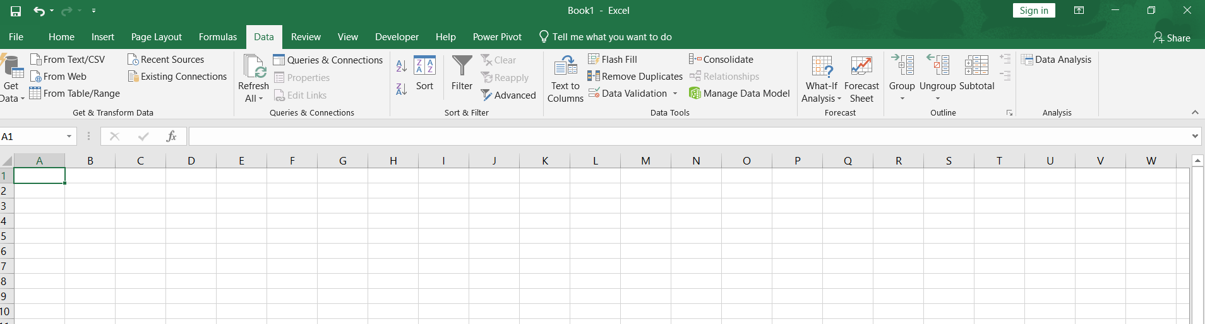
Data Tab
For Getting and Transforming of data
This Group helps to convert text to columns, flash fill, Remove duplicates and applying Data validation
For sort and Filter of data
For Forecasting and Grouping and Ungrouping of rows

Slide 11
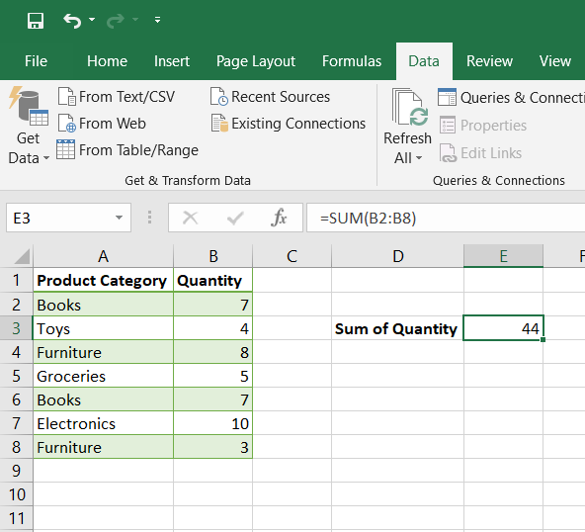
Name Box and Formula Bar
Name Box:
Displays Active Cell Address Or
Named Range.
1
Name Box
Formula Bar
Formula Bar:
Shows cell content or
active formula.
2

Slide 12
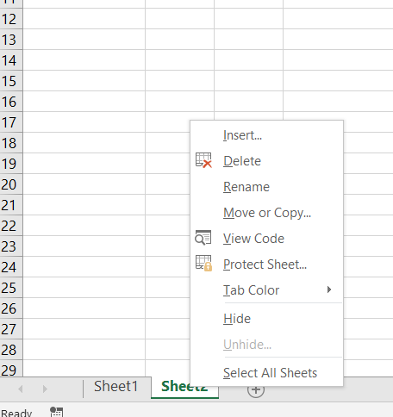
Navigating Worksheets
Methods to Switch Between Worksheets
Right Click on any Worksheet Tab for Navigating between Sheets
Using Worksheet Tabs:
1
  Located at the bottom of the Excel window.
  Click directly on the desired sheet tab to navigate.
  Double-click on a tab to rename it for better iden
Using Right-Click Options:
2
  Right-click on any worksheet tab.
  Select “Move or Copy” to reorder sheets or duplicate them in the same workbook.
Shortcut Key Navigation:
3
  Ctrl + Page Down: Move to the next worksheet.
  Ctrl + Page Up: Move to the previous worksheet.
  Works seamlessly across multiple worksheets.

Slide 13
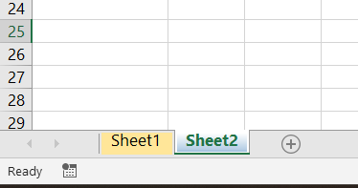
Managing Worksheets
Best Practices for Managing Worksheets
Color-Coding Tabs:
1
  Right-click on a tab, choose “Tab Color,” and assign colors to organize sheets (e.g., red for important, green for completed).
Changing Color to organize Worksheets perfectly
2
Reordering Tabs:
  Drag and drop tabs to rearrange the order.
Hiding/Unhiding Sheets:
3
  To hide: Right-click on a tab and select “Hide.”
  To unhide: Right-click on any tab and select “Unhide,” then choose the desired sheet.

Slide 14
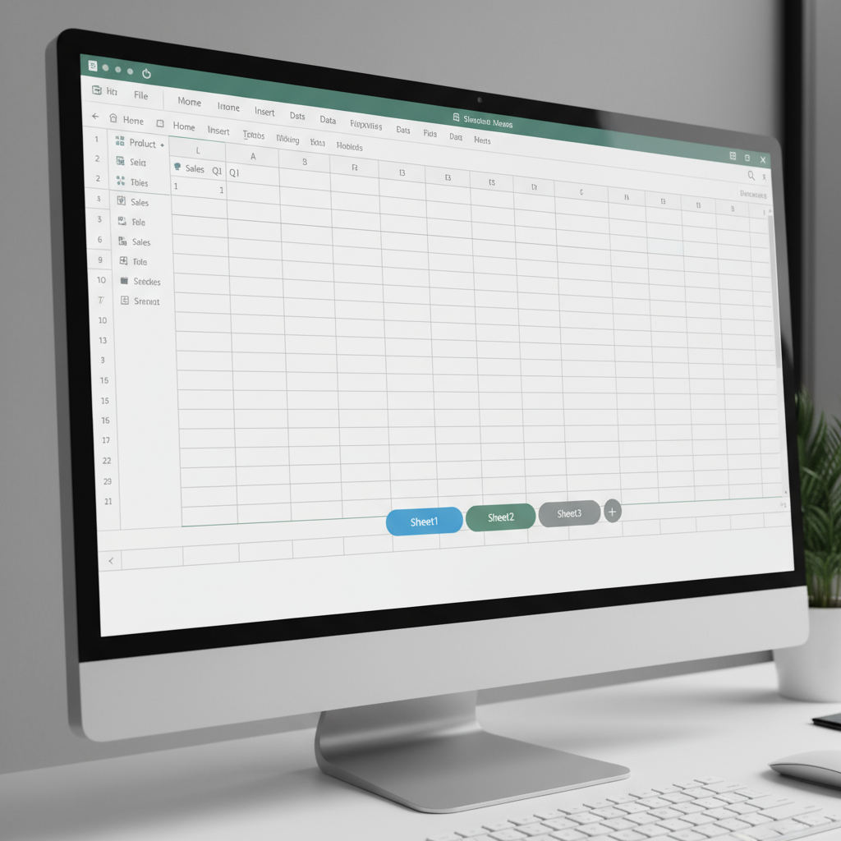
Workbooks vs Worksheets
Workbook :
1
  The entire Excel file (.xlsx)
  Can contain multiple worksheets
  Example: Sales_Report.xlsx
Worksheet :
2
  Individual sheets (tabs) inside a workbook
  Each worksheet is like a page in the file
  Example: Jan Sales, Feb Sales
Think of a workbook like a book → each worksheet is a page in it.

Slide 15

Navigating Cells
1
Use Mouse, Arrow Keys, Or Shortcuts.
Key Shortcut:
1
  Ctrl + Arrow keys: Jump to edges of data.
  Ctrl + Home/End: Move to the beginning/end of a sheet.

Slide 16
Keyboard Shortcuts
Shortcut Key | Function
Ctrl + Arrow Keys | Jump to the edge of a data region in the respective direction.
Ctrl + Home | Move to the first cell (A1) in the worksheet
Ctrl + End | Jump to the last cell with data in the worksheet.
Ctrl + Page Up/Down | Switch between worksheets in the workbook
Shift + Space | Select the entire row of the active cell.
Ctrl + Space | Select the entire column of the active cell.
Alt + Tab | Switch between open Excel workbooks or applications.
F5 or Ctrl + G | Open the "Go To" dialog box to navigate to a specific cell or range.

Slide 17

Cells, Rows
And Columns

Slide 18
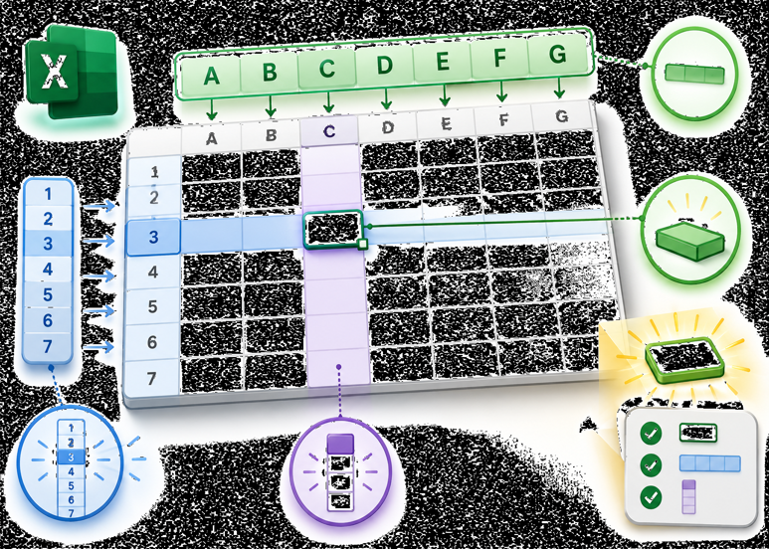
Understanding Cells
Cell = Basic unit in Excel
1
  Each cell has a unique address → (e.g., A1, B2, C10).
  Cell address = Column letter + Row number.
2
Rows = Numbers (1, 2, 3, …)
3
Columns = Letters (A, B, C, …)
Cells Are The Foundation Of Excel Logic — Every Formula, Function, Or Chart Begins With Cells.

Slide 19
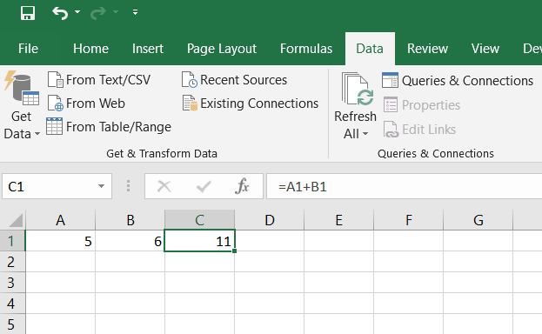
Cell Reference in Excel
Definition:
1
  A way to tell Excel which cell(s) to use in a formula.
2
Example: In =A1 + B1, Excel adds values from cell A1 and cell B1.
Why Important?
3
  References allow formulas to be flexible and reusable.

Slide 20
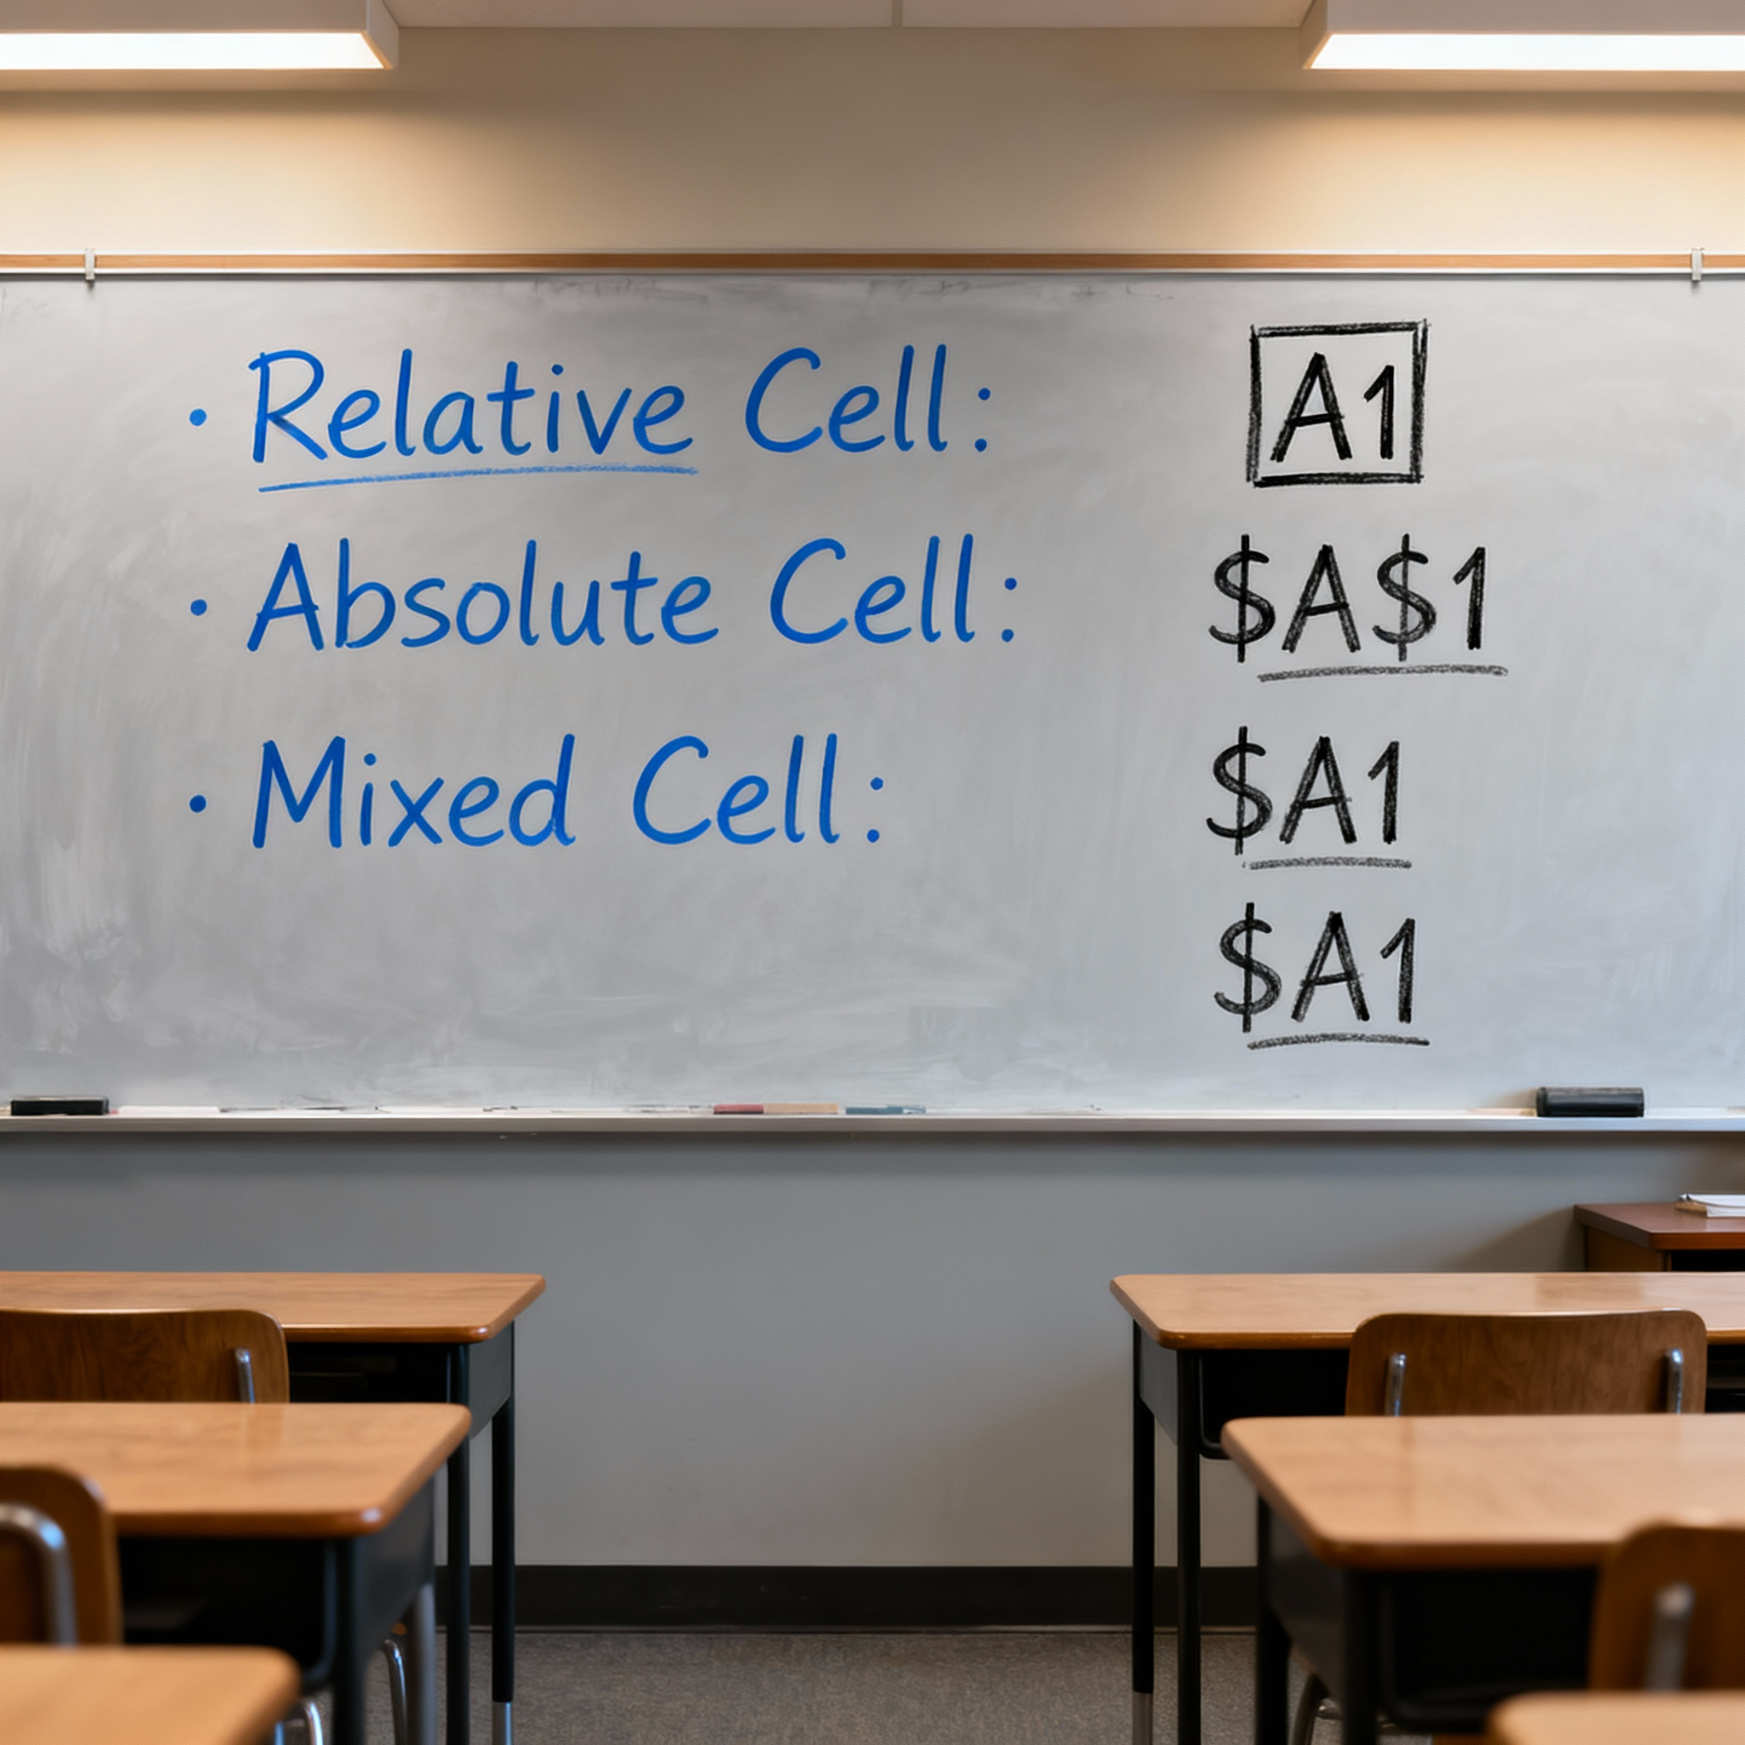
Types of Cell Reference
1
Relative Cell Reference
2
Absolute Cell Reference
3
Mixed Cell Reference

Slide 21
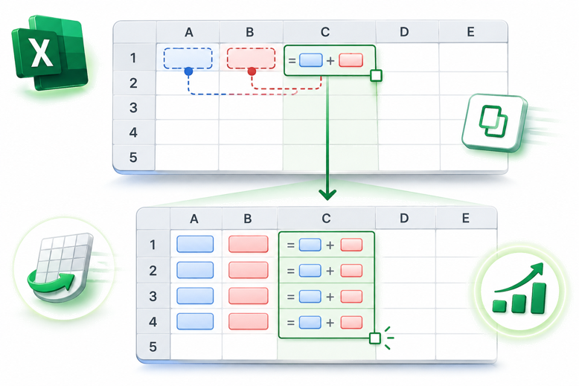
Relative Cell Reference
1
Change automatically when copied to another cell.
2
Example: If =A1 + B1 in cell C1 is copied to C2, it becomes =A2 + B2.
Use Case: Great For Repeating Calculations Across Rows Or
Columns.
3

Slide 22
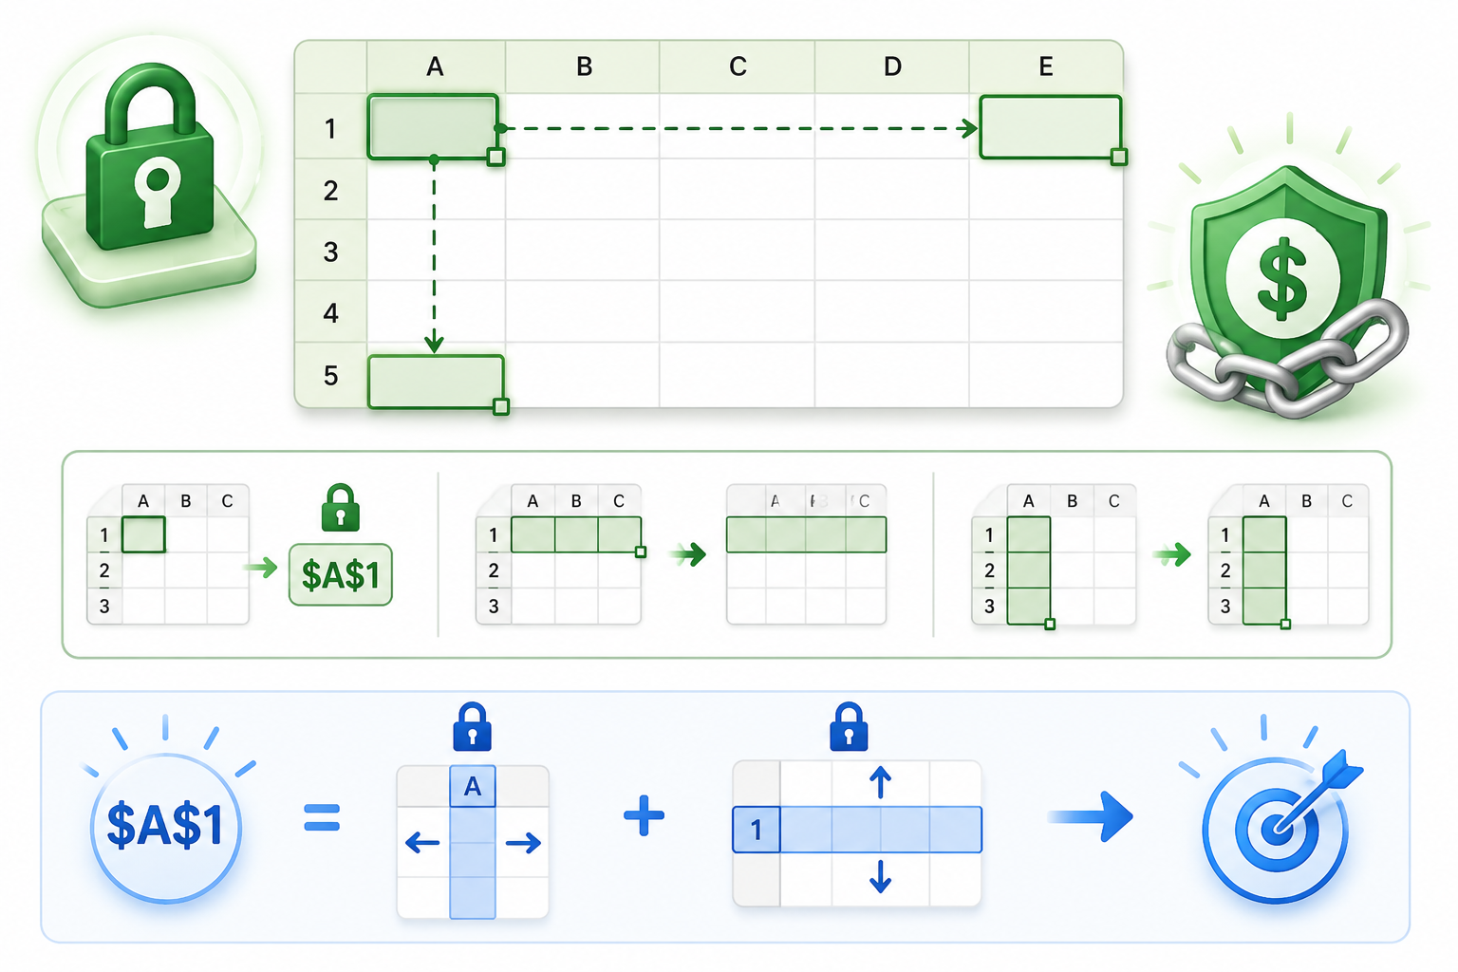
Absolute Cell Reference
1
Remain fixed no matter where the formula is copied.
2
Written with $ sign → $A$1.
3
Example: If =A1 * $B$1 is copied down, only A1 changes, $B$1 stays constant.
4
Use Case: Useful For Fixed Values Like
Tax Rates, Conversion Factors, Constants.

Slide 23
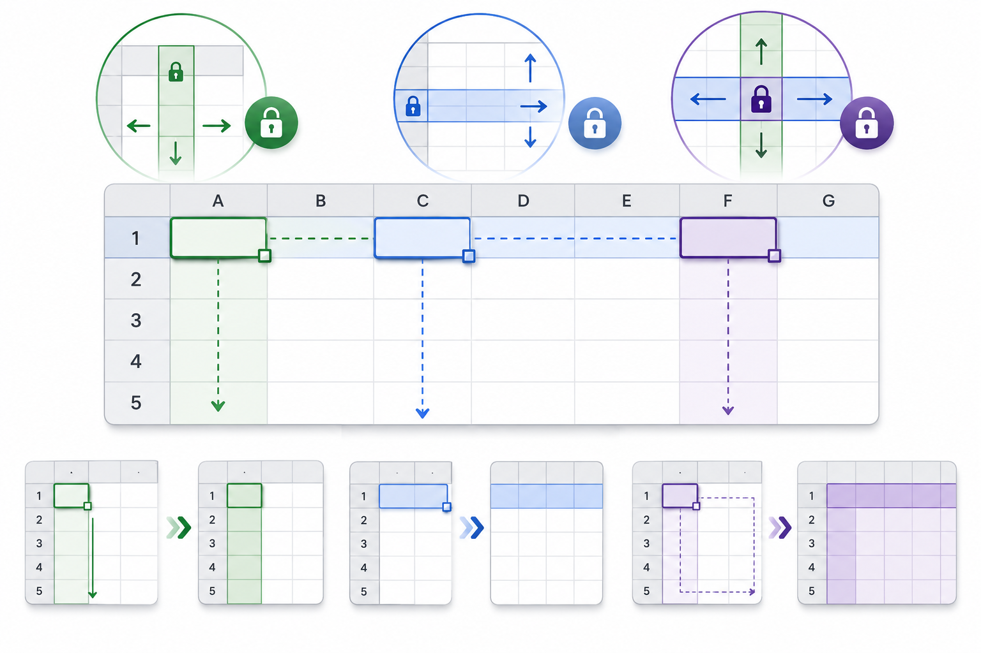
Mixed Cell Reference
1
Combination of relative and absolute.
2
$A1 → column A fixed, row changes.
3
A$1 → Row 1 Fixed, Column Changes.
4
Use case: Helpful in tables or multiplying across both rows and columns.

Slide 24
Why References Matter When Copying Formulas
1
Relative ensures formulas adapt automatically (saves time).
2
Absolute prevents errors when you always need the same value
3
Mixed gives flexibility in row/column operations.
4
Without correct referencing, copied formulas may give wrong results.

Slide 25
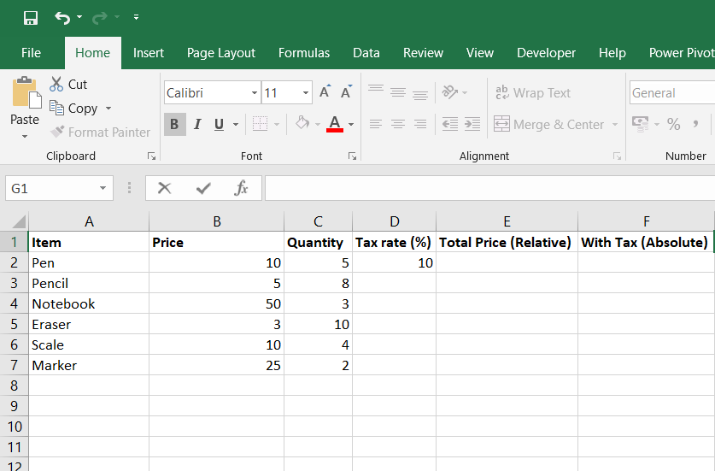
Hands-on Practice
Questions
Relative Cell Reference : In a new column Total, calculate Price × Quantity.
1
Absolute Cell Reference : Assume Tax Rate = 10% in E1.
2
In column With Tax, calculate Total × (1 + Tax Rate).

Slide 26
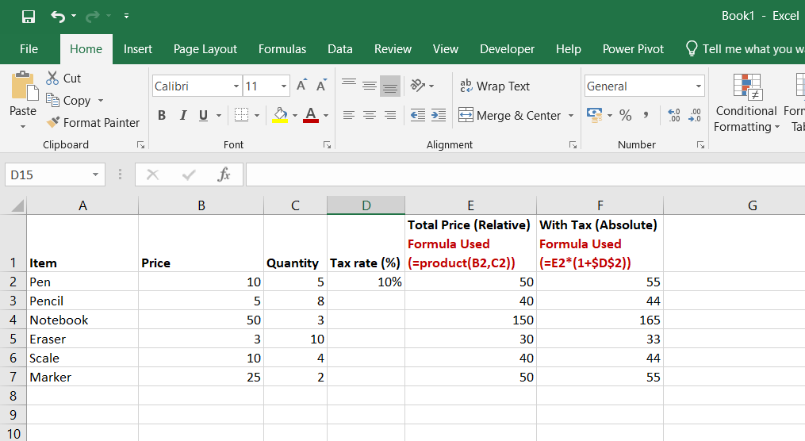
Solution

Slide 27

Data Entry and
Formatting

Slide 28
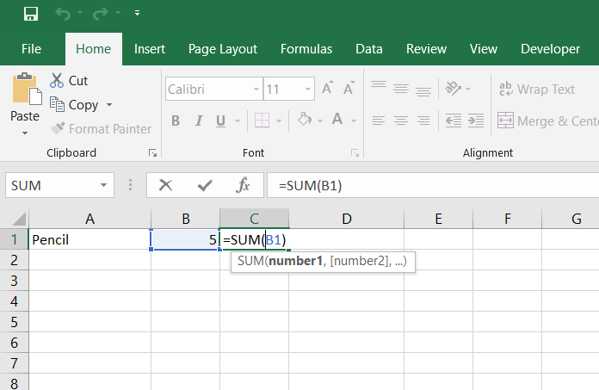
Entering Data
Entering text, numbers, or formulas into cells.
1
Formula
Editing directly in the cell or formula bar.
Number
2
Text

Slide 29
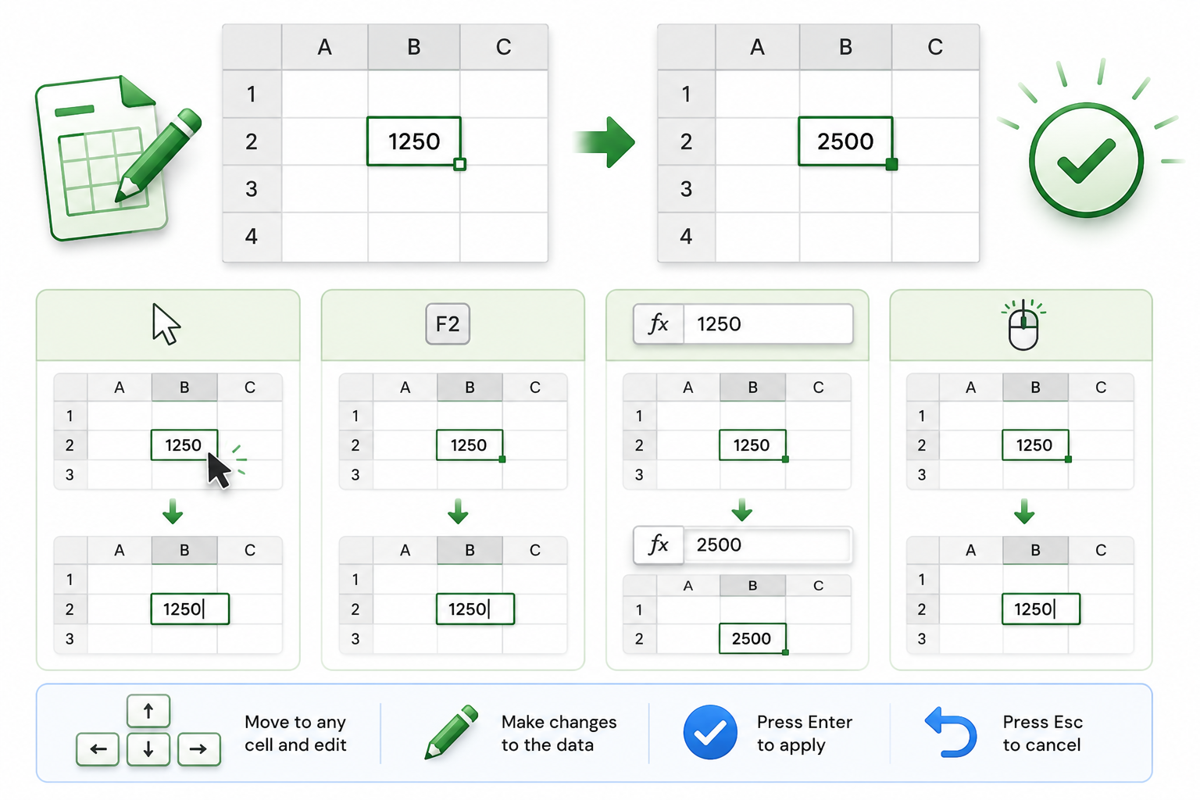
Editing Data
Direct Editing:
1
Double-click the cell to edit its content in place.
Use the F2 key to enable editing.
Formula Bar Editing:
2
Click the cell, and edit the content in the formula bar.
3
Correcting errors using Undo (Ctrl + Z)
or Backspace.

Slide 30
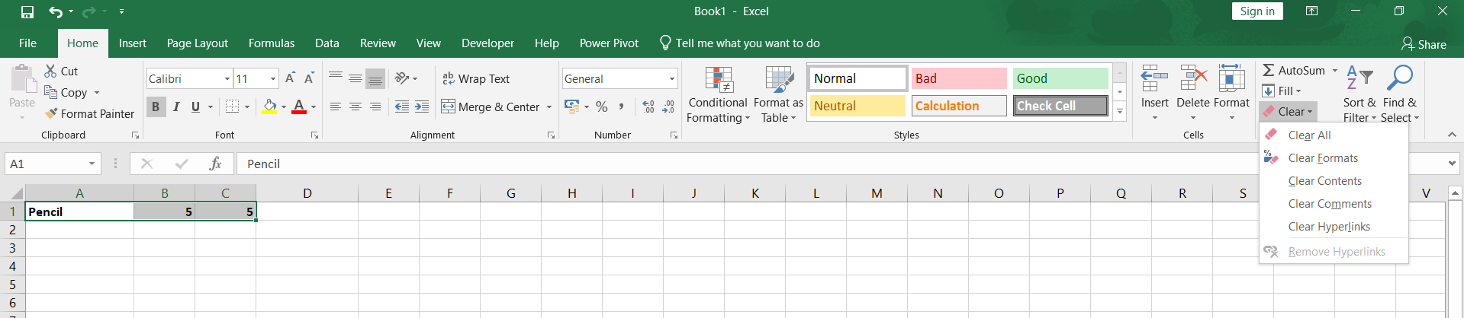
Deleting Data
1
Use The Delete Key To Clear The Content Of A Cell Without Affecting Its Formatting.
Use The Clear Option From The Ribbon For More Options:
2
  Clear All: Removes everything (content, formatting, comments).
  Clear Contents: Removes data but keeps formatting.
  Clear Formats: Removes styling but keeps data.
In Home Tab, click on Clear Option

Slide 31
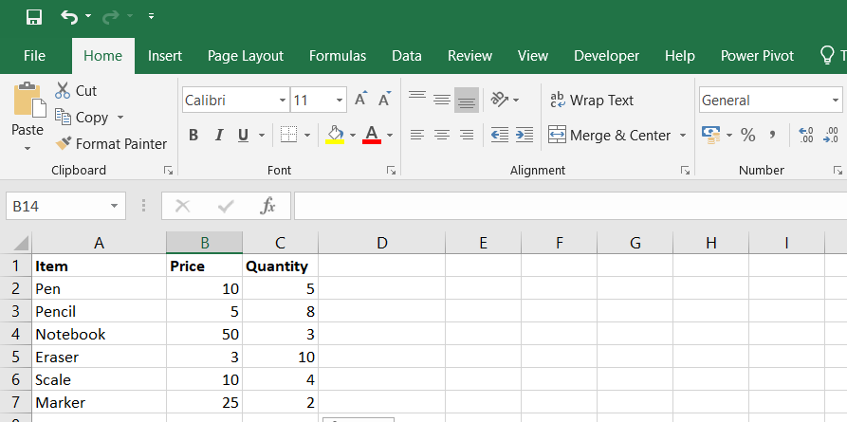
Formatting Basics
Formatting Cells To Improve Readability:
Bold, Italic and Underline
Formatting
  Adjust text alignment: Left, center, or right.
  Apply font styles: Bold, italAic, underline.
  Add borders and shading for emphasis.
1
Text Alignment left, right and center , Merge the cells
2
Use Of Cell Styles (From The Home Tab) To Apply Predefined Formatting.

Slide 32
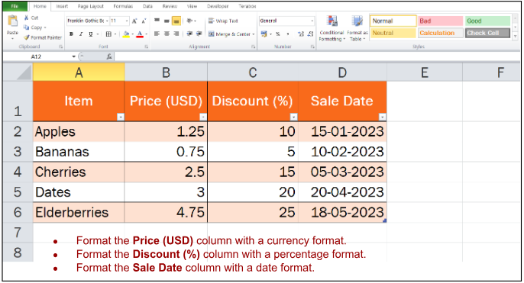
Formatting Numbers
Number Formats Enhance Clarity:
  Currency format for monetary values.
  Percentage format for proportions.
  Date format for calendar entries.
1
How to access number formats:
Ribbon (Home > Number group) or Ctrl + 1
for custom formats.
2

Slide 33
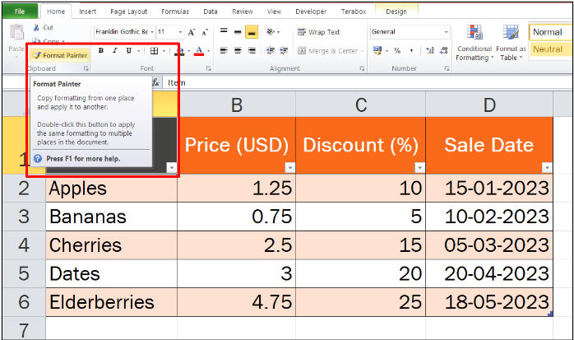
Using Format Painter
1
Format Painter Allows Copying Styles From One Cell Or Range To Another.
How to use it:
2
Select the formatted cell.
Click the Format Painter tool.
Drag over the cells to apply the format.
3
Use double-click to lock the tool for multiple applications.

Slide 34
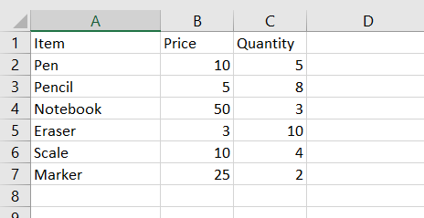
Hands on Activity
Apply the following formatting
1
Headers: Make them bold and centered.
2
Sales (USD): Format the column with a currency style.
3
Borders: Apply borders around the table to improve readability.

Slide 35

Excel
Basics: Sorting
Filtering

Slide 36
Sorting Alphabetically By Name
Name | Score | Date
Anu | 85 | 15-01-2023
Komal | 92 | 20-03-2023
Monika | 95 | 05-03-2023
Niru | 78 | 10-02-2023
Rushi | 88 | 25-01-2023
1
Click Anywhere In The "Name" Column.
2
  Go to the Data tab on the Ribbon.
Click Sort A to Z to sort names alphabetically
in ascending order.
3

Slide 37
Sorting Numerically By Score
Name | Score | Date
Niru | 78 | 10-02-2023
Anu | 85 | 15-01-2023
Rushi | 88 | 25-01-2023
Komal | 92 | 20-03-2023
Monika | 95 | 05-03-2023
1
Click anywhere in the "Score" column.
  In the Data tab, click Sort Smallest to Largest to sort scores in ascending order.
2

Slide 38
Sorting by Date
Name | Score | Date
Anu | 85 | 15-01-2023
Rushi | 88 | 25-01-2023
Niru | 78 | 10-02-2023
Monika | 95 | 05-03-2023
Komal | 92 | 20-03-2023
1
Click anywhere in the "Date" column.
2
  Go to the Data tab, click Sort Oldest to Newest to arrange dates chronologically.

Slide 39
Multi-Level Sorting
1
Sort Data Based On Multiple Criteria:
Example: Sort by Name (A-Z) and then by Score (highest to lowest).
2
Use the Sort dialog box for advanced options.
Select the dataset.
Open the Sort dialog box (Data > Sort).
Add levels and define sorting rules
3
Steps:

Slide 40
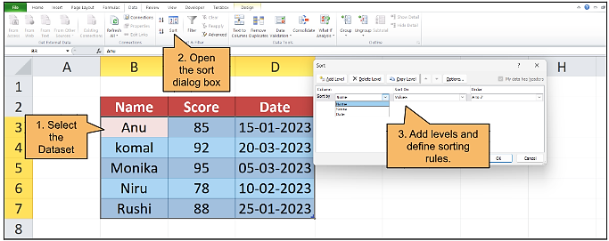
Multi-Level Sorting

Slide 41
Applying Filters
1
Filters hide unwanted data to focus on specific information.
How To Apply:
Select the header row.
Click Filter in the Data tab.
Use dropdown arrows to filter by criteria (e.g., greater than, contains).
2

Slide 42
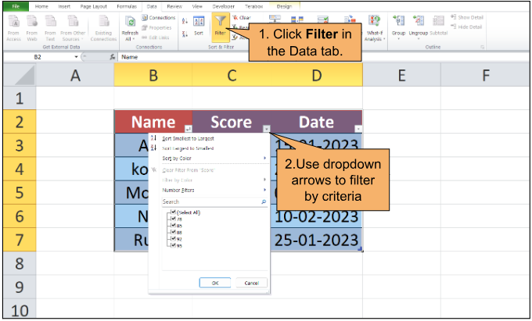
Applying Filters

Slide 43
Common Mistakes in Sorting/Filtering
1
Sorting Without Selecting All Relevant Columns Can Misalign Data.
2
Forgetting To Clear Filters Can Lead To Incomplete Views.

Slide 44
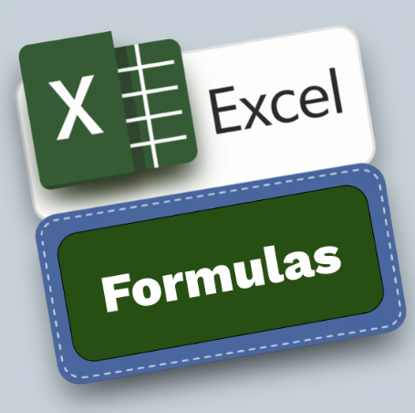
Basic Functions
in Excel

Slide 45
Introduction to Functions
Definition: Functions are predefined formulas in Excel used to perform calculations and simplify data analysis.
1
Why Use Functions?
  Reduce errors in calculations.
  Save time with automation.
  Apply logic across large datasets.
2

Slide 46
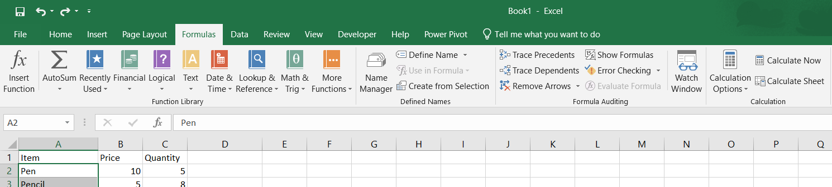
Introduction to Formulas
Click on the Formulas Tab
This is the Functions Library, which contains a variety of functions to perform various calculations and tasks in Excel

Slide 47
Sum Function
Day | Sales
Monday | 200
Tuesday | 250
Wednesday | 300
Total | =SUM(C3:C5)
Purpose: Adds numerical values
in selected cells.
1
2
Syntax: = Sum(range)
Example:
Scenario: Calculating the total sales of a week
3

Slide 48
SUM Related Functions
SUMIF: Adds numbers that meet a specific condition.
1
  Example: = SUMIF(A1:A5, ">10") → Adds only numbers greater than 10 in A1 to A5.
SUMPRODUCT: Multiplies corresponding elements in arrays and sums the results.
2
  Example: = SUMPRODUCT(A1:A5, B1:B5) → Multiplies values in A1 to A5 by B1 to B5 and adds the results

Slide 49
AVERAGE Function
Purpose: Calculates the mean of numbers in selected cells.
Student | Score
Robin | 85
Sachin | 92
Virat | 78
Average | =AVERAGE(C3:C5)
1
2
Syntax: = AVERAGE (range)
Example:
Scenario: Finding the average score of students.
3

Slide 50
AVERAGE Related Functions
AVERAGEIF: Averages numbers that meet a specific condition.
1
  Example: =AVERAGEIF(A1:A5, ">10") → Averages values greater than 10.
AVERAGEIFS: Averages numbers that meet multiple conditions.
2
  Example: =AVERAGEIFS(A1:A5, B1:B5, ">5") → Averages numbers in A1 to A5 where corresponding values in B1 to B5 are > 5.

Slide 51
COUNT Function
Purpose: Counts the number of non-empty cells in a range.
Day | Sales
Laptop | 200
Mouse | 32
Keyboard
Count of product which sale | =COUNT(C3:C5)
1
2
Syntax: = =COUNT(range)
Example:
Scenario: Counting the number of products sold.
3

Slide 52
COUNT Related Functions
1
COUNTA: Counts non-empty cells, including text.
Example: = COUNTA(A1:A5) → Counts all filled cells in A1 to A5.
COUNTBLANK: Counts empty cells in a range.
2
Example: = COUNTA(A1:A5) → Counts all filled cells in A1 to A5.
COUNTIF: Counts cells that meet a specific condition.
3
Example: = COUNTIF(A1:A5, ">10") → Counts cells with values greater than 10.
COUNTIFS: Counts cells that meet multiple conditions.
4
Example: = COUNTIFS(A1:A5, ">10", B1:B5, "<5") → Counts cells where A1 to A5 > 10 and B1 to B5 < 5.’

Slide 53
MIN and MAX Functions
Day | Temperature
Monday | 20
Tuesday | 25
Wednesday | 15
Min Temp. | =MIN(C3:C5)
Min Temp. | =MAX(C3:C5)
=MIN(range) finds the smallest value.
=MAX(range) finds the largest value.
1
Purpose:
Scenario:
Identifying the lowest and highest temperatures in a week.
2
Example:

Slide 54
Result
Min Temperature = 15 degree
&
Max Temperature = 25 degree

Slide 55
Common Errors in Functions
Examples Of Common Errors:
1
#Value!: Invalid Data Type In The Range.
2
#DIV/0!: Division By Zero (E.G., Empty Cell In =AVERAGE).
3
#Ref!: Invalid Reference After Deleting Cells.

Slide 56
Solutions
1
Use Error-checking Tools From The Formulas Tab.
2
Verify Data Types And Range References Before Using Functions.

Slide 57
Key Takeaways
1
Workbooks & Worksheets –
A workbook is an Excel file that can have multiple worksheets (tabs).
2
Cell References
Relative, absolute, and mixed references are essential for working with formulas.
3
Basic Formulas
Functions like SUM, AVERAGE, COUNT, MIN, and MAX form the core of Excel analysis.
4
Formatting & Charts
Clean formatting and simple charts (Column, Line, Pie) make data easier to understand.
5
Foundation for Advanced Analytics
Mastering basics prepares you for advanced features like Pivot Tables.

Slide 58

Thank You
For Attending The Session!!
“Excel Is Not Just About Numbers; It’s About Turning Raw Data Into Stories That Drive Decisions.”
Keep Learning, Keep Upskilling!

